Slide 1
Microsoft Build

Slide 2
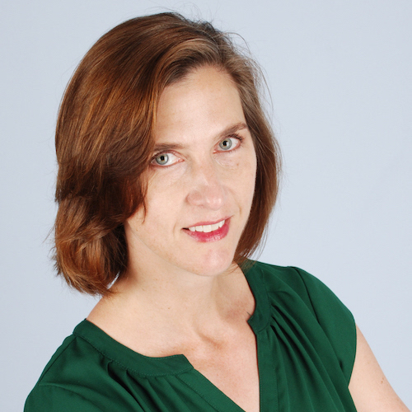
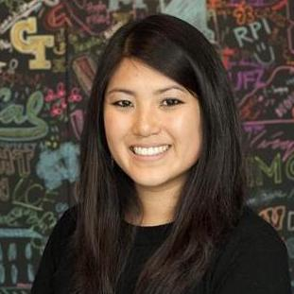
Build your own resume website and stand out to recruiters
Jen Looper
Principal Cloud Developer Advocate
Kristin Straube
University Recruiter

Slide 3


Let’s get started!
Create a GitHub account and login
Go to https://aka.ms/build-22-resume-workshop to follow along!

Slide 4

Learn more
Introduction to JavaScript
https://aka.ms/webdev
Landing an Internship
https://aka.ms/tech-intern
Microsoft Student Ambassador Program
https://aka.ms/studentambassadors
University Careers at Microsoft
https://www.microsoft.com/university
Find these resources and more at the Intro to Tech Skills GitHub Repository!
aka.ms/IntrotoTechSkillsatBuild
Notes:
[note from Angie Doyle: Please ask attendees to tweet #MSBuild AND #IntroToTechSkills if they’re going to tweet]

